Slide 1
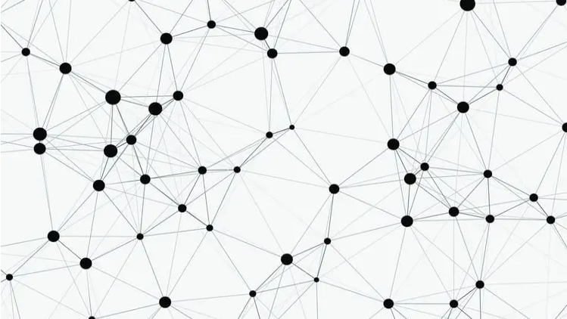
Algorithmic Problem I - Triangulation
Presented By:
Sudur Bhattarai (Matriculation Number: 2514652)

Slide 2
Objective
To discuss the problem with the “Triangulation”.
To discuss the solution strategies to this problem.
To understand the different triangulation algorithms.
To generate the triangulated network from a set of 200 2D-Points with random X and Y coordinates within the interval [0, 10000].

Slide 3
What is triangulation?
Triangulation is the process of partitioning a set of points or polygonal regions into non-overlapping triangles.
A triangulation can be seen as a way of representing the shape and structure of the region or the point set, as well as providing a basis for further geometric operations.

Slide 4
Why is triangulation important?
Important tool for various applications of computational geometry, such as mesh generation, surface reconstruction, and collision detection.
Mesh generation involves creating collections of triangles that approximate a surface or a volume, which is used in computer graphics, engineering, and simulation.
Surface reconstruction uses triangulation to reconstruct a surface from a set of sample points obtained from 3D scanning or imaging.
Collision detection is also enabled by triangulation to detect collisions between objects or between an object and a surface. This is essential for physical simulation, animation, and gaming.

Slide 5
Problems with triangulation
minimum angle
aspect ratio
circumradius-to-shortest edge ratio of the triangles
preserving the boundary, holes, or features of the region
degenerate cases

Slide 6
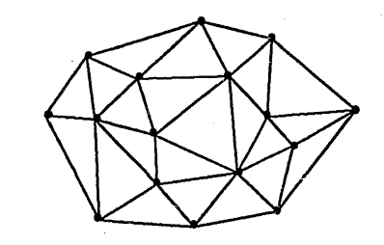
Triangulation algorithm
If we have N points in the plane and join them by non-intersecting straight line segments then every region Interior to the convex hull is a triangle.
Triangulation of a Point Set

Slide 7
Various triangulation algorithm
Delaunay triangulation
Constrained Delaunay triangulation

Slide 8
Delaunay triangulation
most common algorithm in solving triangulation problems in computational geometry.
This algorithm maximizes the minimum angle of the triangles, resulting in high-quality meshes, and also has the property that the circumcircle of any triangle does not contain any other point in the input.

Slide 9
Delaunay triangulation
Based on the “Delaunay criterion”. In the case of 2-D triangulations, this is often called the empty circumcircle criterion.
For a set of points in 2-D, a Delaunay triangulation of these points ensures the circumcircle associated with each triangle contains no other point in its interior.

Slide 10
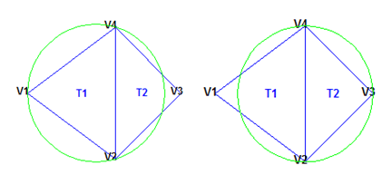
Delaunay triangulation
The circumcircle associated with T1 is empty. It does not contain a point in its interior. The circumcircle associated with T2 is empty. It does not contain a point in its interior. This triangulation is a Delaunay triangulation.

Slide 11
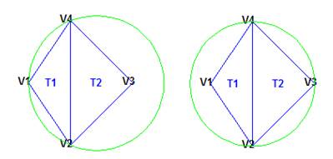
Delaunay triangulation
The circumcircle associated with T1 is not empty. It contains V3 in its interior. The circumcircle associated with T2 is not empty. It contains V1 in its interior. This triangulation is not a Delaunay triangulation.

Slide 12
Methods used by Delaunay triangulation
i. Divide-and-conquer
Divide and conquer may be the fastest Delaunay triangulation algorithm.
The process is to split the vertices into two sets, recursively, then compute the triangulation for each set. The sets are merged along the split line.
ii. Flipping
Flipping is a direct approach.
Start by creating any triangulation, and as non-Delaunay triangles are found, simply flip one of the edges until none remain.
iii. Sweep hull
Sweep hull is a hybrid technique that combines radial propagation from inside the point space to its extent and flipping to achieve triangulation

Slide 13
Methods used by Delaunay triangulation
iv. Incrementalization
This is a basic technique of adding vertices sequentially and correcting the triangulation as necessary at each step.
v. Bowyer-Watson
The Bowyer-Watson method works by iteratively adding points to the triangulation and updating the triangulation structure accordingly.
It is an incremental algorithm that efficiently computes the Delaunay triangulation in a step-by-step manner.

Slide 14
Constrained Delaunay triangulation
Another widely used algorithm that preserves the constraints of the input while still being as close to Delaunay as possible.
This can be done by modifying the Delaunay triangulation algorithm or by using constrained edge insertion or constrained optimization techniques.

Slide 15
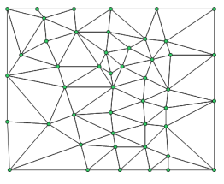
Algorithmic Problem - Triangulation
Input:
A set of 200 2D-Points with random X and Y coordinates within the interval [0, 10000]
Algorithm:
Implementation of a triangulation on the generated point set
Output:
Point List (Point Number, X-Coordinate, Y-Coordinate)
Triangulation (Triangle Number, Point Number 1, Point Number 2, Point Number 3)

Slide 16
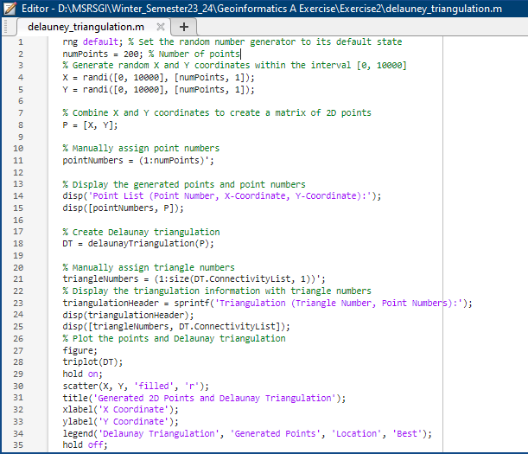
Implementation in MATLAB
DT = delaunayTriangulation(P) creates a Delaunay triangulation from the randomly generated points in P
delaunayTriangulation() function uses
Bowyer-Watson method.

Slide 17
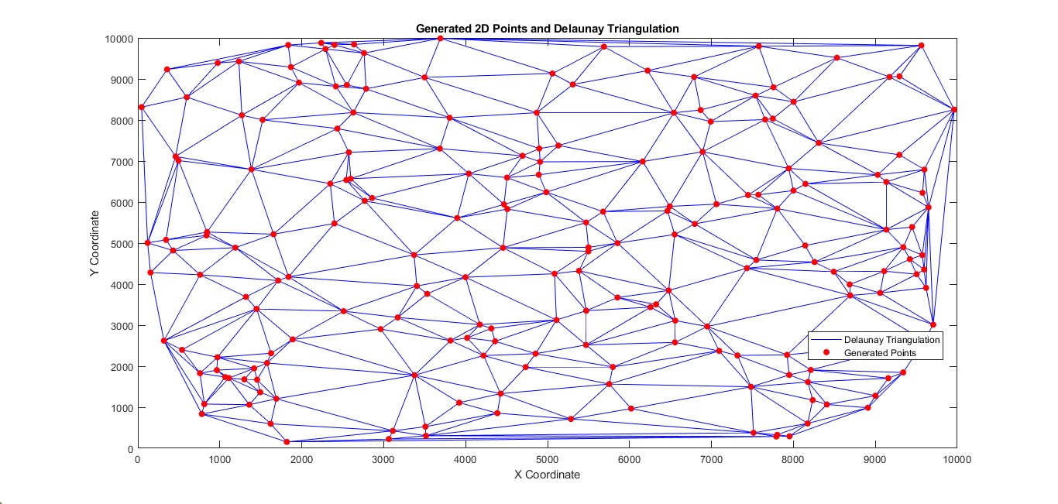
Results

Slide 18

Why Delaunay triangulation and MATLAB?
Capability of Delaunay triangulation algorithm to solve triangulation problem.
Most common that meets the quality, constraints, robustness, complexity, and implementation needs.
Presence of existing function (Delaunay function) that provides the triangulation algorithm.
The algorithm was applied to the input, and the result was checked and found to satisfy our requirements and expectations.

Slide 19
References
https://www.linkedin.com/advice/0/how-can-you-accurately-use-triangulation-algorithms
https://resources.system-analysis.cadence.com/blog/msa2021-using-a-delaunay-triangulation-algorithm-for-mesh-generation
https://www.mathworks.com/help/matlab/math/delaunay-triangulation.html

